Slide 1
IReady Competitive Analysis
Competitor of ALEKS & Achieve3000 Literacy
DAG Marketing
July 2023

Slide 2
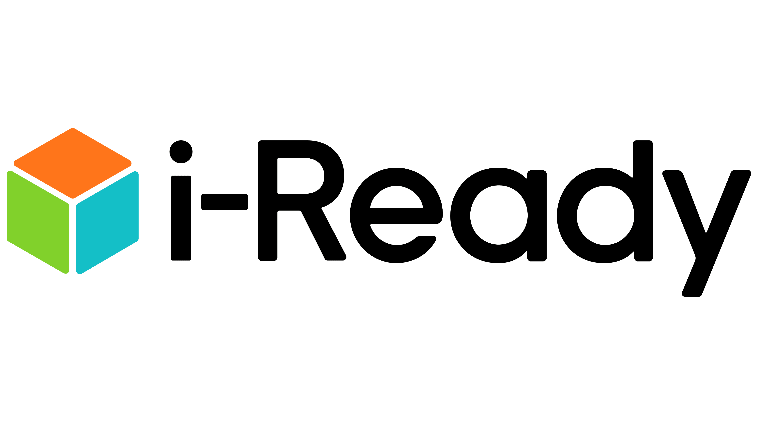
I-Ready
I-Ready provides 5 things at once:
Diagnostic assessment
Data driven insights
Adaptive personalized learning paths
Teacher support
Interactive games for math
What you need to know:
Offers a combination of diagnostic assessments, personalized instruction, instructor resources, and progress monitoring to support student growth in reading and mathematics
Creates personal learning pathways for each student in i-Ready Personalized Instruction
Connects to i-Ready Diagnostic data so teachers can make informed teaching decisions, mainly known as an assessment program
Key programs they offer:
iReady Assessment Diagnostic (K-12) & Standards Mastery Assessment (2-8)
iReady Personalized Instruction (K-8, Math & ELA)
iReady Classroom Mathematics (K-8, Core)
PHONICS for Reading (3-12, Intervention)
Magnetic Reading (K-2, 3-5)
Ready Writing (2-5, Core)
iReady Teacher Toolbox (Math & ELA)
Key features:
Personalized learning paths with adaptive technology
Data-driven insights and diagnostic reporting
Gamified learning with badges, interactive activities, and rewards
Standards-aligned quizzes, shared annotations & video explainers
Reports include suggested “next steps” with links to PDF lessons and activities
Provides scaffolded support that meets the needs of all students’ personalized path

Slide 3
What Sets iReady Apart:
Adaptive Learning & Ownership
Data Driven Culture & Insights
Gamified Learning for K-5
Assessment with Diagnostic
Teacher-Led Messaging
Personalized Learning Paths: iReady's Assessment, analysis, and action approach adapts instruction to each student, providing a personalized path that meets their unique needs and lets them take ownership and agency over their own learning for math and ELA
Provides a one-stop-shop for math and reading adaptive learning under the same i-Ready brand name
Student focused messaging with data connecting students and teachers in the classroom
Research Based: i-Ready’s brand is built on actionable data and an approach based in research (with i-Ready assessment being their flagship product)
i-Ready’s Impact on Massachusetts End of Year assessments was reviewed independently by the Evidence for Every Student Succeeds Act (ESSA) stating that they meet evidence standards
Efficacy studies are robust, easily findable, in-depth by foundational research, unfinished learning, and impact studies
30 state specific efficacy studies measuring the impact of i-Ready on state standards
Standards mastery report can show where students place in each standard
Relevant content: Math Games provide math fluency and skills practice that foster internal motivation while encouraging productive struggle (available to students in i-Ready Mathematics)
Mix of interactive fictional math games for K-2 (like “Hungry Guppy”) and more challenging real-world simulation games for 2-6 (like running a pizza or cupcake business)
The interactive games are engaging and motivating to students with badges, activates, and rewards
In-depth assessments: I-Ready Diagnostic analyzes specific skills and areas of strength and weakness and creates a personalized path for students
This flagship product draws educators into their other suite or programs
Adaptive diagnostic occurs 3x a year and students have 21 days to take it
Instructors can see how students place specifically domain by domain and pushes educators towards resources
Offers Brigance which includes other screening assessments for early childhood, head start, and special education
Supporting teachers: i-Ready diagnostic lets the teacher easily feed information into i-Ready’s math and ELA personalized instruction
Teacher toolbox for math and ELA of collections and resources for teachers to teach prerequisites for students to keep them at grade level state standard
Teacher toolbox includes multimedia content and discourse support

Slide 4
Why is i-Ready so popular?
i-Ready offers adaptive, data-driven math and literacy programs and diagnostic assessments with tools and resources for ongoing teacher support.
Guides and supports teachers with recommendations, “Can Do’s”, and teacher worksheets with “Next Steps”, as well as Teacher Toolbox with resources for individual, small group, and whole group instruction
Centers activities, practice pages, Spanish intervention for K-8
Incorporates data-driven reports and insights including grade and domain progress, activity overview reports, time-on-task, annual growth expectations​, diagnostic reports, and reports of student growth and path to grade-level proficiency for individual students
Reports cluster students into small groups based on shared needs and provides small group instruction to use with those students
Provides real-time feedback to educators on student progress, allowing them to monitor student growth and adjust instruction as needed
Strong brand recognition with multiple products under similar i-Ready branding
Widely known as a diagnostic and assessment program, and promotes that as base offer on top of other products
i-Ready for Students App (regular iPad only, not mini, pro, or phone)​ in Apple Store and Google Play Store
Professional development training on how to use the software is available in online, blended and on-site formats (packages average $2,500 to $3,500 per school site)
Spanish math assessments and materials for grades K-8, accessible closed captioning for prerecorded media in assessments, and screen readers available for students

Slide 5
i-Ready Math Personalized Instruction
Strengths & Weaknesses
The basics:
K-8 adaptive gamified math learning curriculum and online lessons
Powered by insights from I-Ready Diagnostic
Grade K: Includes prerequisite skills for kindergarten math
Grades 1-2: Use visual models and virtual manipulatives to learn numbers through multiple modalities
Grades 3 -8: Instruction and practice with a quiz, real world to help understand the whys behind the how.
Pricing: i-Ready Diagnostic and Instruction start at $30/subject/year. Cannot purchase Instruction without Diagnostic. Min 150 licenses.
Why ALEKS is better:
Teachers can align personalized path with a textbook or scope and sequence based on the precise topics each student is ready to learn without needing assignments.
ALEKS has the learning page, explanation page, and videos. Goes to pre-cursor lesson when student struggles and offers instruction and immediate remediation.
Weekly insights report flags students with activity that that may require teacher intervention: failed topics, decreased learning, unusual learning, procrastination. Updated after student completes a Knowledge Check.
Periodic Knowledge Checks (monthly) determine if recently-learned topics are retained or need more practice; supports mastery and long-term retention. ​
Input your own content for flexible instruction: Teachers can customize assignments, import own content.
Time and Topic Report shows if topic was completed (Learned) or not, and detail for each question attempt: incorrect or correct, time spent on specific question, if Explain page was used, use of help aids. ALEKS pie report and “ready to learn” sections give students and teachers insight into what is needed.
Strengths:
Students can choose to complete lessons from Diagnostic and from teachers and play interactive learning games and activities
Diagnostic reports include instructional strengths, areas of need, and annual growth expectations
Growth Reports provide a detailed portrait of student growth and chart a path to grade-level proficiency for every student.​
Teacher toolbox provides teachers with resources for scaffolding instruction
Reports for Student Grade & Activity Reports, Domain Progress, Activity Overview, and Time-on-Task
Weaknesses:
i-Ready's broad student groups averaged over domain performance in diagnostic​ and is taken 3 times a year at the beginning, middle, and end of the year only
Broadly prescribed based on diagnostic scale score and what students who score in similar range are likely to need
Only at grade level instruction, you have to buy add ons (like math instructional books) to get scaffolding and just in time for struggling students that are below level
No customization, textbook integration; difficult to align instruction to a scope and sequence
6-8 students complain that the games are too childish and made for elementary kids and have similar question types throughout.
Lessons are exploratory and not supportive, and teachers can see that students completed the lesson, but not what questions they got wrong, and you can't pause a lesson or save your work and it quickly times out so you must complete it in one sitting.

Slide 6
i-Ready ELA Personalized Instruction
Strengths & Weaknesses
Strengths:
Combining an adaptive, motivating game-like environment with rigorous, standards-aligned curriculum with immediate feedback for literacy and ELA
Teacher toolbox provides teachers with resources for scaffolding instruction
i-Ready tailors learning paths to each student's individual needs. It assesses their strengths and weaknesses and adjusts the content and difficulty level accordingly, ensuring a personalized and targeted learning experience
The platform provides a wide range of ELA activities and resources, allowing educators to differentiate instruction based on student abilities
The program incorporates interactive and engaging ELA content, including multimedia elements, which can capture students' attention and make learning more enjoyable
Weaknesses:
They have a very serious, data and science heavy brand, which is not very fun and inviting for students
ELA personal instruction primarily relies on digital content and interactions. This approach may not fully replace the benefits of in-person teacher-student interactions, which can include nuanced discussions, immediate feedback, and personalized guidance.
i-Ready may not always foster a deep understanding of the broader context of literary works. They might prioritize skill-building over fostering a genuine love for literature and writing.
i-Ready’s messaging is still focused on unfinished learning from the pandemic
There is no way to ensure students are actively working in the platform like an "are you still here?" Message, so idle time with the platform open is reported as time spent learning.
The basics:
K-8 adaptive gamified ELA learning curriculum and online lessons
Powered by insights from I-Ready Diagnostic
Magnetic Reading is used as a component to this for grades K-5
Gamification for ELA
Pricing: i-Ready Diagnostic starts at $6 per subject, per year. i-Ready Diagnostic and Instruction start at $30 per subject, per year. Cannot purchase Instruction without Diagnostic. Min 150 licenses.
Why Achieve3000 Literacy is better:
12 Lexile levels to differentiate reading easily for teachers and have a standardized benchmark for growth
A3K uses Lexile growth as a concrete benchmark for measuring student growth and more direct with areas of growth for students in specific Lexile growth, i-Ready doesn’t use Lexile growth at all
In Word Studio teachers can find lessons designed to support their students’ needs in literacy and a teacher-led instructional video that can be used independently or in small group instruction
We’re focused on mastery and creating lifelong learners from Smarty, AL, and A3K
i-Ready only has reading and mathematics, where we have culturally relevant text including social studies and science in Actively Lean and A3K
Notes:
RFP teams can use these slides

